Slide 1

Design Patterns
with C++

Slide 2
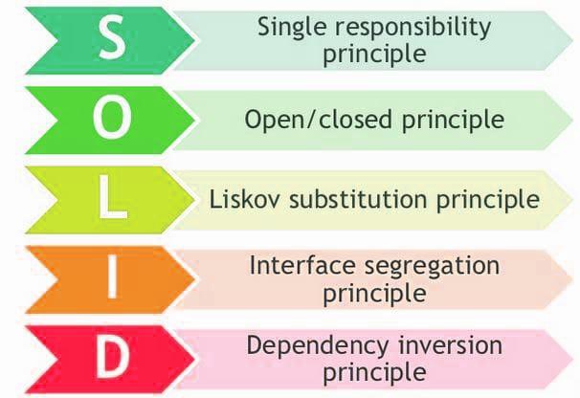
SOLID

Slide 3
Single Responsability PRINCIPLE
A class should have one and only one reason to change, meaning that a class should have only one job

Slide 4
Open-Closed Principle
Objects or entities should be open for extension but closed for modification.

Slide 5
Liskov Substitution Principle
Let q(x) be a property provable about objects of x of type T.
Then q(y) should be provable for objects y of type S where S is a subtype of T.

Slide 6
Interface Segregation Principle
A client should never be forced to implement an interface that it doesn’t use, or clients shouldn’t be forced to depend on methods they do not use.

Slide 7
Dependency Inversion Principle
Entities must depend on abstractions, not on concretions.
It states that the high-level module must not depend on the low-level module, but they should depend on abstractions.

Slide 8
UML
UML (unified modeling language è un linguaggio di modellazione e specifica basato sul paradigma orientato agli oggetti
Il nucleo del linguaggio fu definito nel 1996 da Grady Booch, Jim Rumbaugh e Ivar Jacobson (detti "i tre amigos") sotto l'egida dell'Object Management Group, consorzio che tuttora gestisce lo standard UML
Il linguaggio nacque con l'intento di unificare approcci precedenti (dovuti ai tre padri di UML e altri), raccogliendo le migliori prassi nel settore e definendo così uno standard industriale unificato.
UML svolge un'importantissima funzione di "lingua franca" nella comunità della progettazione e programmazione a oggetti.
Gran parte della letteratura di settore usa UML per descrivere soluzioni analitiche e progettuali in modo sintetico e comprensibile a un vasto pubblico.

Slide 9
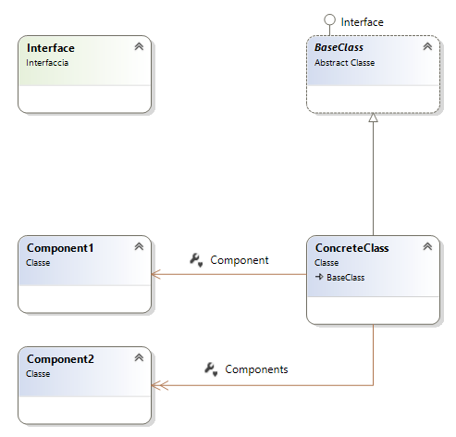
UML - SAMPLE

Slide 10
Design Patterns

Slide 11
What’s a Design Pattern?
Typical solutions to commonly occurring problems in software design
You can’t just find a pattern and copy it into your program
The pattern is not a specific piece of code, but a general concept for solving a particular problem
You can follow the pattern details and implement a solution that suits the realities of your own program
Patterns are often confused with algorithms, because both concepts describe typical solutions to some known problems
While an algorithm always defines a clear set of actions that can achieve some goal, a pattern is a more high-level description of a solution
The code of the same pattern applied to two different programs may be different
Notes:
What’s a design pattern?
Design patterns are typical solutions to commonly occurring problems in software design. They are like pre-made blueprints that you can customize to solve a recurring design problem in your code.
You can’t just find a pattern and copy it into your program, the way you can with off-the-shelf functions or libraries. The pattern is not a specific piece of code, but a general concept for solving a particular problem. You can follow the pattern details and implement a solution that suits the realities of your own program.
Patterns are often confused with algorithms, because both concepts describe typical solutions to some known problems. While an algorithm always defines a clear set of actions that can achieve some goal, a pattern is a more high-level description of a solution. The code of the same pattern applied to two different programs may be different.
An analogy to an algorithm is a cooking recipe: both have clear steps to achieve a goal. On the other hand, a pattern is more like a blueprint: you can see what the result and its features are, but the exact order of implementation is up to you.

Slide 12
pattern
Most patterns are described very formally so people can reproduce them in many contexts:
Intent of the pattern briefly describes both the problem and the solution
Motivation further explains the problem and the solution the pattern makes possible
Structure of classes shows each part of the pattern and how they are related
Code example in one of the popular programming languages makes it easier to grasp the idea behind the pattern
Some pattern catalogs list other useful details
applicability of the pattern
implementation steps
relations with other patterns
Notes:
What does the pattern consist of?
Most patterns are described very formally so people can reproduce them in many contexts. Here are the sections that are usually present in a pattern description:
Intent of the pattern briefly describes both the problem and the solution.
Motivation further explains the problem and the solution the pattern makes possible.
Structure of classes shows each part of the pattern and how they are related.
Code example in one of the popular programming languages makes it easier to grasp the idea behind the pattern.
Some pattern catalogs list other useful details, such as applicability of the pattern, implementation steps and relations with other patterns.

Slide 13
Hystory of Patterns
Christopher Alexander:
A Pattern Language: Towns, Buildings, Construction
The book describes a “language” for designing the urban environment
Erich Gamma, John Vlissides, Ralph Johnson, and Richard Helm (1994):
Design Patterns: Elements of Reusable Object-Oriented Software
Notes:
History of patterns
Who invented patterns? That’s a good, but not a very accurate, question. Design patterns aren’t obscure, sophisticated concepts—quite the opposite. Patterns are typical solutions to common problems in object-oriented design. When a solution gets repeated over and over in various projects, someone eventually puts a name to it and describes the solution in detail. That’s basically how a pattern gets discovered.
The concept of patterns was first described by Christopher Alexander in A Pattern Language: Towns, Buildings, Construction. The book describes a “language” for designing the urban environment. The units of this language are patterns. They may describe how high windows should be, how many levels a building should have, how large green areas in a neighborhood are supposed to be, and so on.
The idea was picked up by four authors: Erich Gamma, John Vlissides, Ralph Johnson, and Richard Helm. In 1994, they published Design Patterns: Elements of Reusable Object-Oriented Software, in which they applied the concept of design patterns to programming. The book featured 23 patterns solving various problems of object-oriented design and became a best-seller very quickly. Due to its lengthy name, people started to call it “the book by the gang of four” which was soon shortened to simply “the GoF book”.
Since then, dozens of other object-oriented patterns have been discovered. The “pattern approach” became very popular in other programming fields, so lots of other patterns now exist outside of object-oriented design as well.

Slide 14
Why Learn Patterns
Toolkit of tried and tested solutions to common problems in software design
Define a common language that you and your teammates can use to communicate more efficiently
Notes:
The truth is that you might manage to work as a programmer for many years without knowing about a single pattern. A lot of people do just that. Even in that case, though, you might be implementing some patterns without even knowing it. So why would you spend time learning them?
Design patterns are a toolkit of tried and tested solutions to common problems in software design. Even if you never encounter these problems, knowing patterns is still useful because it teaches you how to solve all sorts of problems using principles of object-oriented design.
Design patterns define a common language that you and your teammates can use to communicate more efficiently. You can say, “Oh, just use a Singleton for that,” and everyone will understand the idea behind your suggestion. No need to explain what a singleton is if you know the pattern and its name.

Slide 15
Criticism of Patterns
Weak programming language
The programming language must to have the necessary level of abstraction
Inefficient solutions
Patterns try to systematize approaches that are already widely used
Unjustified use: “If all you have is a hammer, everything looks like a nail”
Notes:
Kludges for a weak programming language
Usually the need for patterns arises when people choose a programming language or a technology that lacks the necessary level of abstraction. In this case, patterns become a kludge that gives the language much-needed super-abilities.
For example, the Strategy pattern can be implemented with a simple anonymous (lambda) function in most modern programming languages.
Inefficient solutions
Patterns try to systematize approaches that are already widely used. This unification is viewed by many as a dogma and they implement patterns “to the point”, without adapting them to the context of their project.
Unjustified use
If all you have is a hammer, everything looks like a nail.
This is the problem that haunts many novices who have just familiarized themselves with patterns. Having learned about patterns, they try to apply them everywhere, even in situations where simpler code would do just fine.

Slide 16
Classification of Patterns
Patterns differ by
Complexity
Level of detail
Scale of applicability
Basical classification
Idiom
Achitectural
Notes:
Design patterns differ by their complexity, level of detail and scale of applicability to the entire system being designed. I like the analogy to road construction: you can make an intersection safer by either installing some traffic lights or building an entire multi-level interchange with underground passages for pedestrians.
The most basic and low-level patterns are often called idioms. They usually apply only to a single programming language.
The most universal and high-level patterns are architectural patterns. Developers can implement these patterns in virtually any language. Unlike other patterns, they can be used to design the architecture of an entire application.

Slide 17
Classification of Patterns
All patterns can be categorized by their intent:
Creational Patterns
Provide object creation mechanisms that increase flexibility and reuse of existing code
Structural Patterns
explain how to assemble objects and classes into larger structures, while keeping the structures flexible and efficient
Behavioral Patterns
take care of effective communication and the assignment of responsibilities between objects

Slide 18
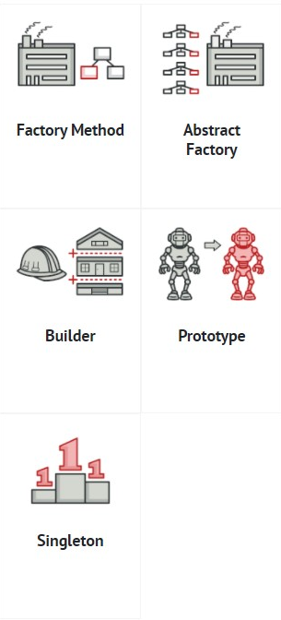
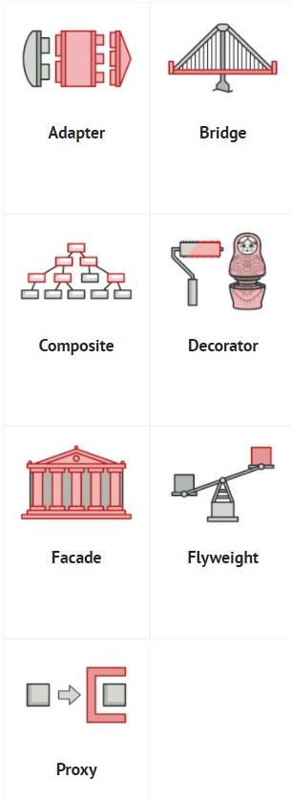
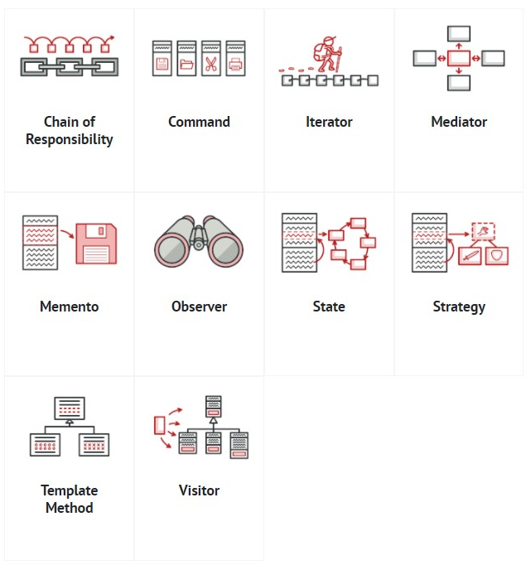
Classification of Patterns
Creational
Structural
Behavioral

Slide 19
Creational Design Patterns
Factory Method
Abstract Factory
Builder
Prototype
Singleton

Slide 20
Factory Method
Intent
Factory Method is a creational design pattern that provides an interface for creating objects in a superclass, but allows subclasses to alter the type of objects that will be created
Problem
Your application must add another type of entity without continuously make changes again and again

Slide 21
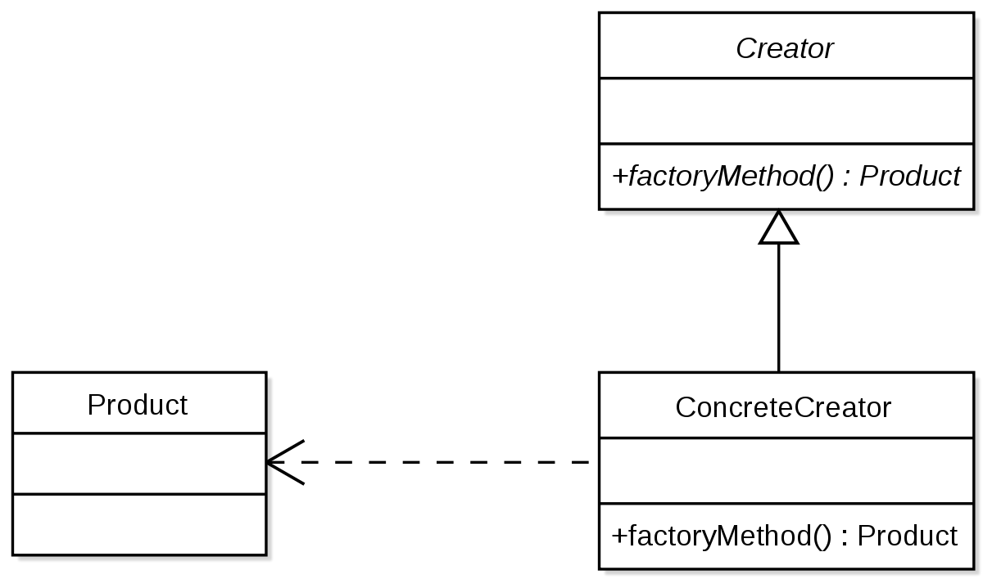
Factory Method - Structure

Slide 22
Factory Method – Usage in C++
See:
FactoryMethodSample Project in the code
Notes:
Applicability
Use the Factory Method when you don’t know beforehand the exact types and dependencies of the objects your code should work with.
The Factory Method separates product construction code from the code that actually uses the product. Therefore it’s easier to extend the product construction code independently from the rest of the code.
For example, to add a new product type to the app, you’ll only need to create a new creator subclass and override the factory method in it.
Use the Factory Method when you want to provide users of your library or framework with a way to extend its internal components.
Inheritance is probably the easiest way to extend the default behavior of a library or framework. But how would the framework recognize that your subclass should be used instead of a standard component?
The solution is to reduce the code that constructs components across the framework into a single factory method and let anyone override this method in addition to extending the component itself.
Let’s see how that would work. Imagine that you write an app using an open source UI framework. Your app should have round buttons, but the framework only provides square ones. You extend the standard Button class with a glorious RoundButton subclass. But now you need to tell the main UIFramework class to use the new button subclass instead of a default one.
To achieve this, you create a subclass UIWithRoundButtons from a base framework class and override its createButton method. While this method returns Button objects in the base class, you make your subclass return RoundButton objects. Now use the UIWithRoundButtons class instead of UIFramework. And that’s about it!
Use the Factory Method when you want to save system resources by reusing existing objects instead of rebuilding them each time.
You often experience this need when dealing with large, resource-intensive objects such as database connections, file systems, and network resources.
Let’s think about what has to be done to reuse an existing object:
First, you need to create some storage to keep track of all of the created objects.
When someone requests an object, the program should look for a free object inside that pool.
… and then return it to the client code.
If there are no free objects, the program should create a new one (and add it to the pool).
That’s a lot of code! And it must all be put into a single place so that you don’t pollute the program with duplicate code.
Probably the most obvious and convenient place where this code could be placed is the constructor of the class whose objects we’re trying to reuse. However, a constructor must always return new objects by definition. It can’t return existing instances.
Therefore, you need to have a regular method capable of creating new objects as well as reusing existing ones. That sounds very much like a factory method.
How to Implement
Make all products follow the same interface. This interface should declare methods that make sense in every product.
Add an empty factory method inside the creator class. The return type of the method should match the common product interface.
In the creator’s code find all references to product constructors. One by one, replace them with calls to the factory method, while extracting the product creation code into the factory method.
You might need to add a temporary parameter to the factory method to control the type of returned product.
At this point, the code of the factory method may look pretty ugly. It may have a large switch operator that picks which product class to instantiate. But don’t worry, we’ll fix it soon enough.
Now, create a set of creator subclasses for each type of product listed in the factory method. Override the factory method in the subclasses and extract the appropriate bits of construction code from the base method.
If there are too many product types and it doesn’t make sense to create subclasses for all of them, you can reuse the control parameter from the base class in subclasses.
For instance, imagine that you have the following hierarchy of classes: the base Mail class with a couple of subclasses: AirMail and GroundMail; the Transport classes are Plane, Truck and Train. While the AirMail class only uses Plane objects, GroundMail may work with both Truck and Train objects. You can create a new subclass (say TrainMail) to handle both cases, but there’s another option. The client code can pass an argument to the factory method of the GroundMail class to control which product it wants to receive.
If, after all of the extractions, the base factory method has become empty, you can make it abstract. If there’s something left, you can make it a default behavior of the method.

Slide 23
Pros and Cons
You avoid tight coupling between the creator and the concrete products.
Single Responsibility Principle
You can move the product creation code into one place in the program, making the code easier to support.
Open/Closed Principle
You can introduce new types of products into the program without breaking existing client code.
The code may become more complicated
You need to introduce a lot of new subclasses to implement the pattern
The best case scenario is when you’re introducing the pattern into an existing hierarchy of creator classes
Notes:
Relations with Other Patterns
Many designs start by using Factory Method (less complicated and more customizable via subclasses) and evolve toward Abstract Factory, Prototype, or Builder (more flexible, but more complicated).
Abstract Factory classes are often based on a set of Factory Methods, but you can also use Prototype to compose the methods on these classes.
You can use Factory Method along with Iterator to let collection subclasses return different types of iterators that are compatible with the collections.
Prototype isn’t based on inheritance, so it doesn’t have its drawbacks. On the other hand, Prototype requires a complicated initialization of the cloned object. Factory Method is based on inheritance but doesn’t require an initialization step.
Factory Method is a specialization of Template Method. At the same time, a Factory Method may serve as a step in a large Template Method.

Slide 24
Abstract Factory
The Abstract Factory pattern is pretty common in C++ code
Many frameworks and libraries use it to provide a way to extend and customize their standard components
The pattern is easy to recognize by methods, which return a factory object
Then, the factory is used for creating specific sub-components
Notes:
Applicability
Use the Factory Method when you don’t know beforehand the exact types and dependencies of the objects your code should work with.
The Factory Method separates product construction code from the code that actually uses the product. Therefore it’s easier to extend the product construction code independently from the rest of the code.
For example, to add a new product type to the app, you’ll only need to create a new creator subclass and override the factory method in it.
Use the Factory Method when you want to provide users of your library or framework with a way to extend its internal components.
Inheritance is probably the easiest way to extend the default behavior of a library or framework. But how would the framework recognize that your subclass should be used instead of a standard component?
The solution is to reduce the code that constructs components across the framework into a single factory method and let anyone override this method in addition to extending the component itself.
Let’s see how that would work. Imagine that you write an app using an open source UI framework. Your app should have round buttons, but the framework only provides square ones. You extend the standard Button class with a glorious RoundButton subclass. But now you need to tell the main UIFramework class to use the new button subclass instead of a default one.
To achieve this, you create a subclass UIWithRoundButtons from a base framework class and override its createButton method. While this method returns Button objects in the base class, you make your subclass return RoundButton objects. Now use the UIWithRoundButtons class instead of UIFramework. And that’s about it!
Use the Factory Method when you want to save system resources by reusing existing objects instead of rebuilding them each time.
You often experience this need when dealing with large, resource-intensive objects such as database connections, file systems, and network resources.
Let’s think about what has to be done to reuse an existing object:
First, you need to create some storage to keep track of all of the created objects.
When someone requests an object, the program should look for a free object inside that pool.
… and then return it to the client code.
If there are no free objects, the program should create a new one (and add it to the pool).
That’s a lot of code! And it must all be put into a single place so that you don’t pollute the program with duplicate code.
Probably the most obvious and convenient place where this code could be placed is the constructor of the class whose objects we’re trying to reuse. However, a constructor must always return new objects by definition. It can’t return existing instances.
Therefore, you need to have a regular method capable of creating new objects as well as reusing existing ones. That sounds very much like a factory method.

Slide 25
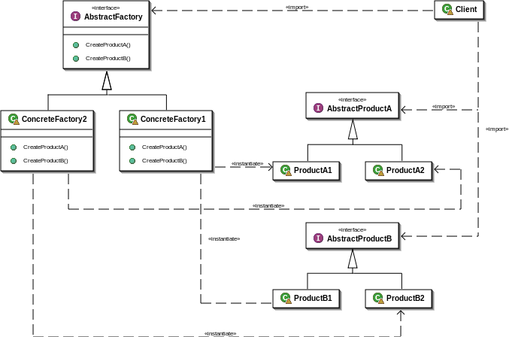
Abstract Factory - Structure

Slide 26
Abstract Factory – Usage in C++
See:
AbstractFactorySample Project in the code
Notes:
Applicability
Use the Abstract Factory when your code needs to work with various families of related products, but you don’t want it to depend on the concrete classes of those products—they might be unknown beforehand or you simply want to allow for future extensibility.
The Abstract Factory provides you with an interface for creating objects from each class of the product family. As long as your code creates objects via this interface, you don’t have to worry about creating the wrong variant of a product which doesn’t match the products already created by your app.
Consider implementing the Abstract Factory when you have a class with a set of Factory Methods that blur its primary responsibility.
In a well-designed program each class is responsible only for one thing. When a class deals with multiple product types, it may be worth extracting its factory methods into a stand-alone factory class or a full-blown Abstract Factory implementation.
How to Implement
Map out a matrix of distinct product types versus variants of these products.
Declare abstract product interfaces for all product types. Then make all concrete product classes implement these interfaces.
Declare the abstract factory interface with a set of creation methods for all abstract products.
Implement a set of concrete factory classes, one for each product variant.
Create factory initialization code somewhere in the app. It should instantiate one of the concrete factory classes, depending on the application configuration or the current environment. Pass this factory object to all classes that construct products.
Scan through the code and find all direct calls to product constructors. Replace them with calls to the appropriate creation method on the factory object.
How to Implement
Map out a matrix of distinct product types versus variants of these products.
Declare abstract product interfaces for all product types. Then make all concrete product classes implement these interfaces.
Declare the abstract factory interface with a set of creation methods for all abstract products.
Implement a set of concrete factory classes, one for each product variant.
Create factory initialization code somewhere in the app. It should instantiate one of the concrete factory classes, depending on the application configuration or the current environment. Pass this factory object to all classes that construct products.
Scan through the code and find all direct calls to product constructors. Replace them with calls to the appropriate creation method on the factory object.

Slide 27
Pros and Cons
You can be sure that the products you’re getting from a factory are compatible with each other.
You avoid tight coupling between concrete products and client code.
Single Responsibility Principle
You can extract the product creation code into one place, making the code easier to support.
Open/Closed Principle
You can introduce new types of products into the program without breaking existing client code.
The code may become more complicated than it should be
a lot of new interfaces and classes are introduced along with the pattern.
Notes:
Relations with Other Patterns
Many designs start by using Factory Method (less complicated and more customizable via subclasses) and evolve toward Abstract Factory, Prototype, or Builder (more flexible, but more complicated).
Abstract Factory classes are often based on a set of Factory Methods, but you can also use Prototype to compose the methods on these classes.
You can use Factory Method along with Iterator to let collection subclasses return different types of iterators that are compatible with the collections.
Prototype isn’t based on inheritance, so it doesn’t have its drawbacks. On the other hand, Prototype requires a complicated initialization of the cloned object. Factory Method is based on inheritance but doesn’t require an initialization step.
Factory Method is a specialization of Template Method. At the same time, a Factory Method may serve as a step in a large Template Method.

Slide 28
Builder
Intent
Lets you construct complex objects step by step. The pattern allows you to produce different types and representations of an object using the same construction code.
Problem
Imagine a complex object that requires laborious, step-by-step initialization of many fields and nested objects: initialization code is usually buried inside a monstrous constructor with lots of parameters.

Slide 29
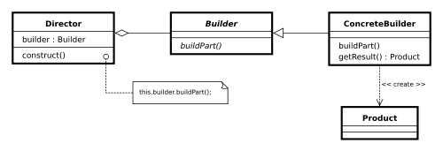
Builder - Structure

Slide 30
Builder – Usage in C++
See:
BuilderSample Project in the code
Notes:
How to Implement
Make sure that you can clearly define the common construction steps for building all available product representations. Otherwise, you won’t be able to proceed with implementing the pattern.
Declare these steps in the base builder interface.
Create a concrete builder class for each of the product representations and implement their construction steps.
Don’t forget about implementing a method for fetching the result of the construction. The reason why this method can’t be declared inside the builder interface is that various builders may construct products that don’t have a common interface. Therefore, you don’t know what would be the return type for such a method. However, if you’re dealing with products from a single hierarchy, the fetching method can be safely added to the base interface.
Think about creating a director class. It may encapsulate various ways to construct a product using the same builder object.
The client code creates both the builder and the director objects. Before construction starts, the client must pass a builder object to the director. Usually, the client does this only once, via parameters of the director’s constructor. The director uses the builder object in all further construction. There’s an alternative approach, where the builder is passed directly to the construction method of the director.
The construction result can be obtained directly from the director only if all products follow the same interface. Otherwise, the client should fetch the result from the builder.

Slide 31
Pros and Cons
You can construct objects step-by-step, defer construction steps or run steps recursively.
You can reuse the same construction code when building various representations of products.
Single Responsibility Principle
You can isolate complex construction code from the business logic of the product.
The overall complexity of the code increases since the pattern requires creating multiple new classes
Notes:
Relations with Other Patterns
Many designs start by using Factory Method (less complicated and more customizable via subclasses) and evolve toward Abstract Factory, Prototype, or Builder (more flexible, but more complicated).
Builder focuses on constructing complex objects step by step. Abstract Factory specializes in creating families of related objects. Abstract Factory returns the product immediately, whereas Builder lets you run some additional construction steps before fetching the product.
You can use Builder when creating complex Composite trees because you can program its construction steps to work recursively.
You can combine Builder with Bridge: the director class plays the role of the abstraction, while different builders act as implementations.
Abstract Factories, Builders and Prototypes can all be implemented as Singletons.

Slide 32
Prototype
Intent
Lets you copy existing objects without making your code dependent on their classes.
Problem
You want to create an exact copy of an existing object.
Some of the object’s fields may be private and not visible from outside of the object itself.

Slide 33
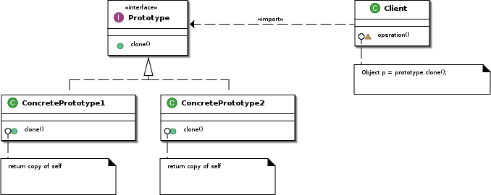
Prototype - Structure

Slide 34
Prototype – Usage in C++
See:
PrototypeSample Project in the code
Notes:
How to Implement
Make sure that you can clearly define the common construction steps for building all available product representations. Otherwise, you won’t be able to proceed with implementing the pattern.
Declare these steps in the base builder interface.
Create a concrete builder class for each of the product representations and implement their construction steps.
Don’t forget about implementing a method for fetching the result of the construction. The reason why this method can’t be declared inside the builder interface is that various builders may construct products that don’t have a common interface. Therefore, you don’t know what would be the return type for such a method. However, if you’re dealing with products from a single hierarchy, the fetching method can be safely added to the base interface.
Think about creating a director class. It may encapsulate various ways to construct a product using the same builder object.
The client code creates both the builder and the director objects. Before construction starts, the client must pass a builder object to the director. Usually, the client does this only once, via parameters of the director’s constructor. The director uses the builder object in all further construction. There’s an alternative approach, where the builder is passed directly to the construction method of the director.
The construction result can be obtained directly from the director only if all products follow the same interface. Otherwise, the client should fetch the result from the builder.

Slide 35
Pros and Cons
You can clone objects without coupling to their concrete classes.
You can get rid of repeated initialization code in favor of cloning pre-built prototypes.
You can produce complex objects more conveniently.
You get an alternative to inheritance when dealing with configuration presets for complex objects.
Cloning complex objects that have circular references might be very tricky.
Notes:
Relations with Other Patterns
Many designs start by using Factory Method (less complicated and more customizable via subclasses) and evolve toward Abstract Factory, Prototype, or Builder (more flexible, but more complicated).
Abstract Factory classes are often based on a set of Factory Methods, but you can also use Prototype to compose the methods on these classes.
Prototype can help when you need to save copies of Commands into history.
Designs that make heavy use of Composite and Decorator can often benefit from using Prototype. Applying the pattern lets you clone complex structures instead of re-constructing them from scratch.
Prototype isn’t based on inheritance, so it doesn’t have its drawbacks. On the other hand, Prototype requires a complicated initialization of the cloned object. Factory Method is based on inheritance but doesn’t require an initialization step.
Sometimes Prototype can be a simpler alternative to Memento. This works if the object, the state of which you want to store in the history, is fairly straightforward and doesn’t have links to external resources, or the links are easy to re-establish.
Abstract Factories, Builders and Prototypes can all be implemented as Singletons.

Slide 36
Singleton
Intent
Lets you ensure that a class has only one instance, while providing a global access point to this instance.
Problem
The Singleton pattern solves two problems at the same time, violating the Single Responsibility Principle:
Ensure that a class has just a single instance
Provide a global access point to that instance
Notes:
Problem
The Singleton pattern solves two problems at the same time, violating the Single Responsibility Principle:
Ensure that a class has just a single instance. Why would anyone want to control how many instances a class has? The most common reason for this is to control access to some shared resource—for example, a database or a file.
Here’s how it works: imagine that you created an object, but after a while decided to create a new one. Instead of receiving a fresh object, you’ll get the one you already created.
Note that this behavior is impossible to implement with a regular constructor since a constructor call must always return a new object by design.
Provide a global access point to that instance. Remember those global variables that you (all right, me) used to store some essential objects? While they’re very handy, they’re also very unsafe since any code can potentially overwrite the contents of those variables and crash the app.
Just like a global variable, the Singleton pattern lets you access some object from anywhere in the program. However, it also protects that instance from being overwritten by other code.
There’s another side to this problem: you don’t want the code that solves problem #1 to be scattered all over your program. It’s much better to have it within one class, especially if the rest of your code already depends on it.
Nowadays, the Singleton pattern has become so popular that people may call something a singleton even if it solves just one of the listed problems.

Slide 37
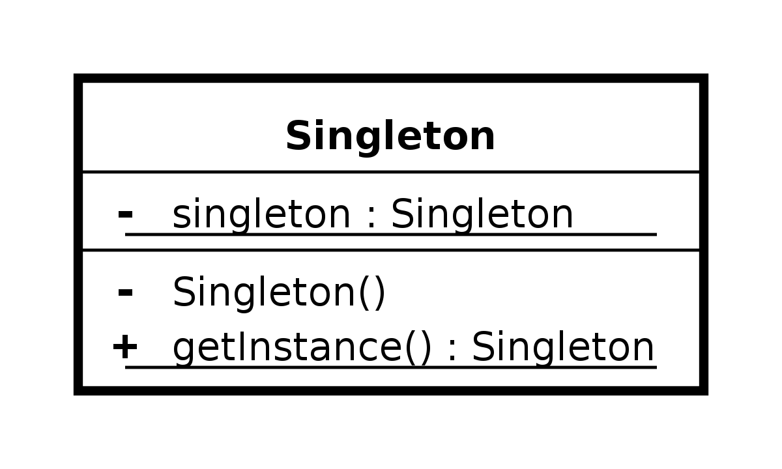
Singleton - Structure

Slide 38
Singleton – Usage in C++
See:
SingletonSample Project in the code
Notes:
How to Implement
Make sure that you can clearly define the common construction steps for building all available product representations. Otherwise, you won’t be able to proceed with implementing the pattern.
Declare these steps in the base builder interface.
Create a concrete builder class for each of the product representations and implement their construction steps.
Don’t forget about implementing a method for fetching the result of the construction. The reason why this method can’t be declared inside the builder interface is that various builders may construct products that don’t have a common interface. Therefore, you don’t know what would be the return type for such a method. However, if you’re dealing with products from a single hierarchy, the fetching method can be safely added to the base interface.
Think about creating a director class. It may encapsulate various ways to construct a product using the same builder object.
The client code creates both the builder and the director objects. Before construction starts, the client must pass a builder object to the director. Usually, the client does this only once, via parameters of the director’s constructor. The director uses the builder object in all further construction. There’s an alternative approach, where the builder is passed directly to the construction method of the director.
The construction result can be obtained directly from the director only if all products follow the same interface. Otherwise, the client should fetch the result from the builder.

Slide 39
Pros and Cons
You can be sure that a class has only a single instance.
You gain a global access point to that instance.
You can produce complex objects more conveniently.
The singleton object is initialized only when it’s requested for the first time.
Violates the Single Responsibility Principle. The pattern solves two problems at the time.
The Singleton pattern can mask bad design, for instance, when the components of the program know too much about each other.
The pattern requires special treatment in a multithreaded environment so that multiple threads won’t create a singleton object several times.
It may be difficult to unit test the client code.
Notes:
Cons
It may be difficult to unit test the client code of the Singleton because many test frameworks rely on inheritance when producing mock objects. Since the constructor of the singleton class is private and overriding static methods is impossible in most languages, you will need to think of a creative way to mock the singleton. Or just don’t write the tests. Or don’t use the Singleton pattern.
Relations with Other Patterns
A Facade class can often be transformed into a Singleton since a single facade object is sufficient in most cases.
Flyweight would resemble Singleton if you somehow managed to reduce all shared states of the objects to just one flyweight object. But there are two fundamental differences between these patterns:
There should be only one Singleton instance, whereas a Flyweight class can have multiple instances with different intrinsic states.
The Singleton object can be mutable. Flyweight objects are immutable.
Abstract Factories, Builders and Prototypes can all be implemented as Singletons.

Slide 40
Structural Design Patterns
Adapter
Bridge
Composite
Decorator
Façade
Flyweight
Proxy

Slide 41
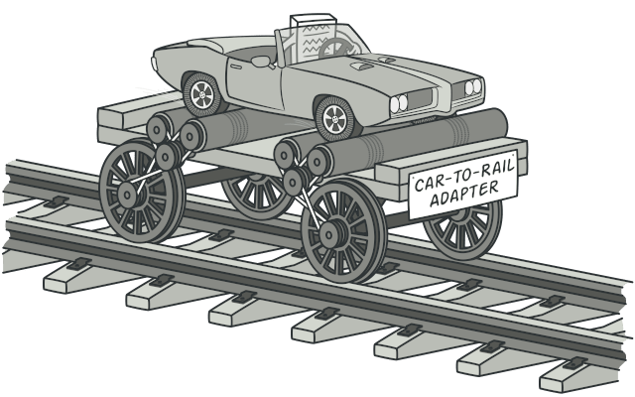
Adapter
Intent
Allows objects with incompatible interfaces to collaborate.
Problem
Adapt interfaces of incompatibles types.

Slide 42
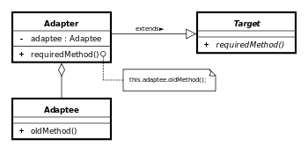
Adapter - Structure

Slide 43
ADAPTER – Usage in C++
See:
AdapterSample Project in the code
Notes:
The Adapter pattern is pretty common in C++ code. It’s very often used in systems based on some legacy code. In such cases, Adapters make legacy code work with modern classes.
How to Implement
Make sure that you have at least two classes with incompatible interfaces:
A useful service class, which you can’t change (often 3rd-party, legacy or with lots of existing dependencies).
One or several client classes that would benefit from using the service class.
Declare the client interface and describe how clients communicate with the service.
Create the adapter class and make it follow the client interface. Leave all the methods empty for now.
Add a field to the adapter class to store a reference to the service object. The common practice is to initialize this field via the constructor, but sometimes it’s more convenient to pass it to the adapter when calling its methods.
One by one, implement all methods of the client interface in the adapter class. The adapter should delegate most of the real work to the service object, handling only the interface or data format conversion.
Clients should use the adapter via the client interface. This will let you change or extend the adapters without affecting the client code.

Slide 44
Pros and Cons
Single Responsibility Principle. You can separate the interface or data conversion code from the primary business logic of the program.
Open/Closed Principle. You can introduce new types of adapters into the program without breaking the existing client code, as long as they work with the adapters through the client interface.
The overall complexity of the code increases because you need to introduce a set of new interfaces and classes. Sometimes it’s simpler just to change the service class so that it matches the rest of your code.
Notes:
Relations with Other Patterns
Bridge is usually designed up-front, letting you develop parts of an application independently of each other. On the other hand, Adapter is commonly used with an existing app to make some otherwise-incompatible classes work together nicely.
Adapter changes the interface of an existing object, while Decorator enhances an object without changing its interface. In addition, Decorator supports recursive composition, which isn’t possible when you use Adapter.
Adapter provides a different interface to the wrapped object, Proxy provides it with the same interface, and Decorator provides it with an enhanced interface.
Facade defines a new interface for existing objects, whereas Adapter tries to make the existing interface usable. Adapter usually wraps just one object, while Facade works with an entire subsystem of objects.
Bridge, State, Strategy (and to some degree Adapter) have very similar structures. Indeed, all of these patterns are based on composition, which is delegating work to other objects. However, they all solve different problems. A pattern isn’t just a recipe for structuring your code in a specific way. It can also communicate to other developers the problem the pattern solves.

Slide 45
Bridge
Intent
Lets you split a large class or a set of closely related classes into two separate hierarchies—abstraction and implementation—which can be developed independently of each other.
Problem
Abstraction? Implementation? Sound scary? Stay calm!

Slide 46
Abstract and Implementation
GoF book introduces the terms Abstraction and Implementation as part of the Bridge definition.
Abstraction (also called interface) is a high-level control layer for some entity.
It should delegate the work to the implementation layer (also called platform).
Notes:
bstraction and Implementation
The GoF book introduces the terms Abstraction and Implementation as part of the Bridge definition. In my opinion, the terms sound too academic and make the pattern seem more complicated than it really is. Having read the simple example with shapes and colors, let’s decipher the meaning behind the GoF book’s scary words.
Abstraction (also called interface) is a high-level control layer for some entity. This layer isn’t supposed to do any real work on its own. It should delegate the work to the implementation layer (also called platform).
Note that we’re not talking about interfaces or abstract classes from your programming language. These aren’t the same things.
When talking about real applications, the abstraction can be represented by a graphical user interface (GUI), and the implementation could be the underlying operating system code (API) which the GUI layer calls in response to user interactions.
Generally speaking, you can extend such an app in two independent directions:
Have several different GUIs (for instance, tailored for regular customers or admins).
Support several different APIs (for example, to be able to launch the app under Windows, Linux, and macOS).
In a worst-case scenario, this app might look like a giant spaghetti bowl, where hundreds of conditionals connect different types of GUI with various APIs all over the code.
You can bring order to this chaos by extracting the code related to specific interface-platform combinations into separate classes. However, soon you’ll discover that there are lots of these classes. The class hierarchy will grow exponentially because adding a new GUI or supporting a different API would require creating more and more classes.
Let’s try to solve this issue with the Bridge pattern. It suggests that we divide the classes into two hierarchies:
Abstraction: the GUI layer of the app.
Implementation: the operating systems’ APIs.
The abstraction object controls the appearance of the app, delegating the actual work to the linked implementation object. Different implementations are interchangeable as long as they follow a common interface, enabling the same GUI to work under Windows and Linux.
As a result, you can change the GUI classes without touching the API-related classes. Moreover, adding support for another operating system only requires creating a subclass in the implementation hierarchy.

Slide 47
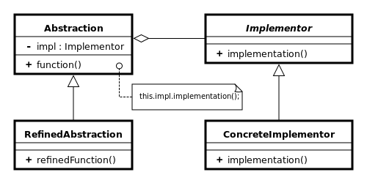
Bridge - Structure
Notes:
How to Implement
Identify the orthogonal dimensions in your classes. These independent concepts could be: abstraction/platform, domain/infrastructure, front-end/back-end, or interface/implementation.
See what operations the client needs and define them in the base abstraction class.
Determine the operations available on all platforms. Declare the ones that the abstraction needs in the general implementation interface.
For all platforms in your domain create concrete implementation classes, but make sure they all follow the implementation interface.
Inside the abstraction class, add a reference field for the implementation type. The abstraction delegates most of the work to the implementation object that’s referenced in that field.
If you have several variants of high-level logic, create refined abstractions for each variant by extending the base abstraction class.
The client code should pass an implementation object to the abstraction’s constructor to associate one with the other. After that, the client can forget about the implementation and work only with the abstraction object.

Slide 48
BRIDGE – Usage in C++
See:
BridgeSample Project in the code
Notes:
How to Implement
Identify the orthogonal dimensions in your classes. These independent concepts could be: abstraction/platform, domain/infrastructure, front-end/back-end, or interface/implementation.
See what operations the client needs and define them in the base abstraction class.
Determine the operations available on all platforms. Declare the ones that the abstraction needs in the general implementation interface.
For all platforms in your domain create concrete implementation classes, but make sure they all follow the implementation interface.
Inside the abstraction class, add a reference field for the implementation type. The abstraction delegates most of the work to the implementation object that’s referenced in that field.
If you have several variants of high-level logic, create refined abstractions for each variant by extending the base abstraction class.
The client code should pass an implementation object to the abstraction’s constructor to associate one with the other. After that, the client can forget about the implementation and work only with the abstraction object.

Slide 49
Pros and Cons
You can create platform-independent classes and apps.
The client code works with high-level abstractions. It isn’t exposed to the platform details.
Open/Closed Principle. You can introduce new abstractions and implementations independently from each other.
Single Responsibility Principle. You can focus on high-level logic in the abstraction and on platform details in the implementation.
You might make the code more complicated by applying the pattern to a highly cohesive class.
Notes:
Relations with Other Patterns
Bridge is usually designed up-front, letting you develop parts of an application independently of each other. On the other hand, Adapter is commonly used with an existing app to make some otherwise-incompatible classes work together nicely.
Bridge, State, Strategy (and to some degree Adapter) have very similar structures. Indeed, all of these patterns are based on composition, which is delegating work to other objects. However, they all solve different problems. A pattern isn’t just a recipe for structuring your code in a specific way. It can also communicate to other developers the problem the pattern solves.
You can use Abstract Factory along with Bridge. This pairing is useful when some abstractions defined by Bridge can only work with specific implementations. In this case, Abstract Factory can encapsulate these relations and hide the complexity from the client code.
You can combine Builder with Bridge: the director class plays the role of the abstraction, while different builders act as implementations.

Slide 50
Composite
Intent
Lets you compose objects into tree structures and then work with these structures as if they were individual objects.
Problem
Pattern makes sense only when the core model of your app can be represented as a tree.

Slide 51
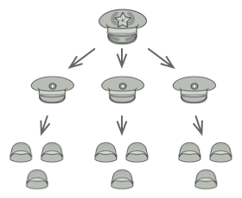
COMPOSIT – Real World Analogy
Armies of most countries are structured as hierarchies.
An army consists of several divisions;
a division is a set of brigades,
a brigade consists of platoons
broken down into squads
Finally, a squad is a small group of real soldiers.
Orders are given at the top of the hierarchy and passed down onto each level until every soldier knows what needs to be done.

Slide 52
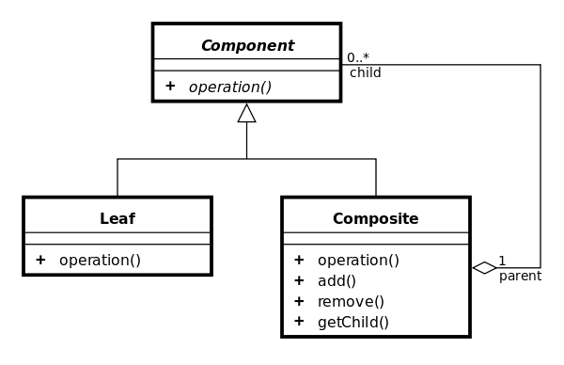
Composite - Structure
Notes:
Applicability
Use the Composite pattern when you have to implement a tree-like object structure.
The Composite pattern provides you with two basic element types that share a common interface: simple leaves and complex containers. A container can be composed of both leaves and other containers. This lets you construct a nested recursive object structure that resembles a tree.
Use the pattern when you want the client code to treat both simple and complex elements uniformly.
All elements defined by the Composite pattern share a common interface. Using this interface, the client doesn’t have to worry about the concrete class of the objects it works with.

Slide 53
Composite – Usage in C++
See:
CompositeSample Project in the code
Notes:
How to Implement
Make sure that the core model of your app can be represented as a tree structure. Try to break it down into simple elements and containers. Remember that containers must be able to contain both simple elements and other containers.
Declare the component interface with a list of methods that make sense for both simple and complex components.
Create a leaf class to represent simple elements. A program may have multiple different leaf classes.
Create a container class to represent complex elements. In this class, provide an array field for storing references to sub-elements. The array must be able to store both leaves and containers, so make sure it’s declared with the component interface type.
While implementing the methods of the component interface, remember that a container is supposed to be delegating most of the work to sub-elements.
Finally, define the methods for adding and removal of child elements in the container.
Keep in mind that these operations can be declared in the component interface. This would violate the Interface Segregation Principle because the methods will be empty in the leaf class. However, the client will be able to treat all the elements equally, even when composing the tree.

Slide 54
Pros and Cons
You can work with complex tree structures more conveniently: use polymorphism and recursion to your advantage.
Open/Closed Principle. You can introduce new element types into the app without breaking the existing code, which now works with the object tree.
It might be difficult to provide a common interface for classes whose functionality differs too much. In certain scenarios, you’d need to overgeneralize the component interface, making it harder to comprehend.
Notes:
Relations with Other Patterns
You can use Builder when creating complex Composite trees because you can program its construction steps to work recursively.
Chain of Responsibility is often used in conjunction with Composite. In this case, when a leaf component gets a request, it may pass it through the chain of all of the parent components down to the root of the object tree.
You can use Iterators to traverse Composite trees.
You can use Visitor to execute an operation over an entire Composite tree.
You can implement shared leaf nodes of the Composite tree as Flyweights to save some RAM.
Composite and Decorator have similar structure diagrams since both rely on recursive composition to organize an open-ended number of objects.
A Decorator is like a Composite but only has one child component. There’s another significant difference: Decorator adds additional responsibilities to the wrapped object, while Composite just “sums up” its children’s results.
However, the patterns can also cooperate: you can use Decorator to extend the behavior of a specific object in the Composite tree.
Designs that make heavy use of Composite and Decorator can often benefit from using Prototype. Applying the pattern lets you clone complex structures instead of re-constructing them from scratch.

Slide 55
Decorator
Intent
Decorator is a structural design pattern that lets you attach new behaviors to objects by placing these objects inside special wrapper objects that contain the behaviors.
Problem
You’re working with a library by a method and you need other behaviors added to this method.

Slide 56
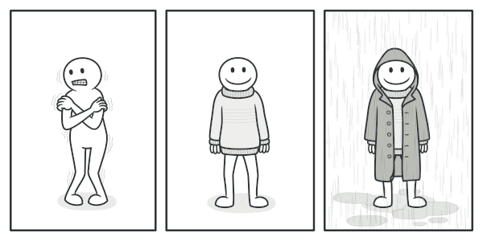
Real World Analogy

Slide 57
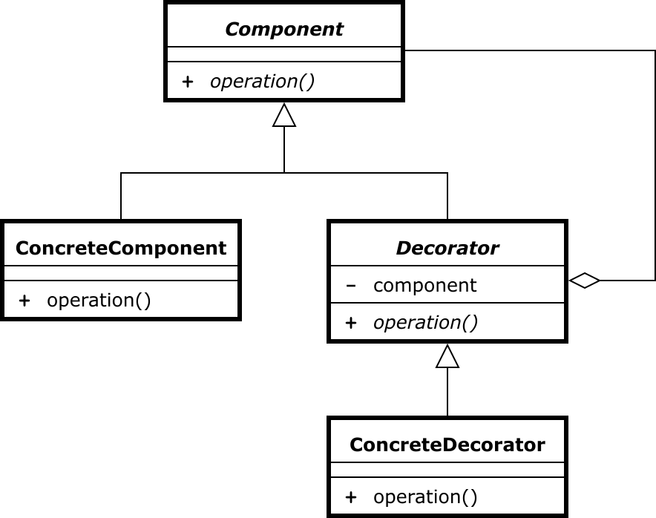
Decorator - Structure
Notes:
Applicability
Use the Decorator pattern when you need to be able to assign extra behaviors to objects at runtime without breaking the code that uses these objects.
The Decorator lets you structure your business logic into layers, create a decorator for each layer and compose objects with various combinations of this logic at runtime. The client code can treat all these objects in the same way, since they all follow a common interface.
Use the pattern when it’s awkward or not possible to extend an object’s behavior using inheritance.
Many programming languages have the final keyword that can be used to prevent further extension of a class. For a final class, the only way to reuse the existing behavior would be to wrap the class with your own wrapper, using the Decorator pattern.

Slide 58
Decorator – Usage in C++
See:
DecoratorSample Project in the code
Notes:
How to Implement
Make sure your business domain can be represented as a primary component with multiple optional layers over it.
Figure out what methods are common to both the primary component and the optional layers. Create a component interface and declare those methods there.
Create a concrete component class and define the base behavior in it.
Create a base decorator class. It should have a field for storing a reference to a wrapped object. The field should be declared with the component interface type to allow linking to concrete components as well as decorators. The base decorator must delegate all work to the wrapped object.
Make sure all classes implement the component interface.
Create concrete decorators by extending them from the base decorator. A concrete decorator must execute its behavior before or after the call to the parent method (which always delegates to the wrapped object).
The client code must be responsible for creating decorators and composing them in the way the client needs.

Slide 59
Pros and Cons
You can extend an object’s behavior without making a new subclass.
You can add or remove responsibilities from an object at runtime.
You can combine several behaviors by wrapping an object into multiple decorators.
Single Responsibility Principle. You can divide a monolithic class that implements many possible variants of behavior into several smaller classes.
It’s hard to remove a specific wrapper from the wrappers stack.
It’s hard to implement a decorator in such a way that its behavior doesn’t depend on the order in the decorators stack.
The initial configuration code of layers might look pretty ugly.
Notes:
Relations with Other Patterns
Adapter changes the interface of an existing object, while Decorator enhances an object without changing its interface. In addition, Decorator supports recursive composition, which isn’t possible when you use Adapter.
Adapter provides a different interface to the wrapped object, Proxy provides it with the same interface, and Decorator provides it with an enhanced interface.
Chain of Responsibility and Decorator have very similar class structures. Both patterns rely on recursive composition to pass the execution through a series of objects. However, there are several crucial differences.
The CoR handlers can execute arbitrary operations independently of each other. They can also stop passing the request further at any point. On the other hand, various Decorators can extend the object’s behavior while keeping it consistent with the base interface. In addition, decorators aren’t allowed to break the flow of the request.
Composite and Decorator have similar structure diagrams since both rely on recursive composition to organize an open-ended number of objects.
A Decorator is like a Composite but only has one child component. There’s another significant difference: Decorator adds additional responsibilities to the wrapped object, while Composite just “sums up” its children’s results.
However, the patterns can also cooperate: you can use Decorator to extend the behavior of a specific object in the Composite tree.
Designs that make heavy use of Composite and Decorator can often benefit from using Prototype. Applying the pattern lets you clone complex structures instead of re-constructing them from scratch.
Decorator lets you change the skin of an object, while Strategy lets you change the guts.
Decorator and Proxy have similar structures, but very different intents. Both patterns are built on the composition principle, where one object is supposed to delegate some of the work to another. The difference is that a Proxy usually manages the life cycle of its service object on its own, whereas the composition of Decorators is always controlled by the client.

Slide 60
Facade
Intent
Provides a simplified interface to a library, a framework, or any other complex set of classes.
Problem
To work with a broad set of objects that belong to a sophisticated library or framework can be very hard.

Slide 61
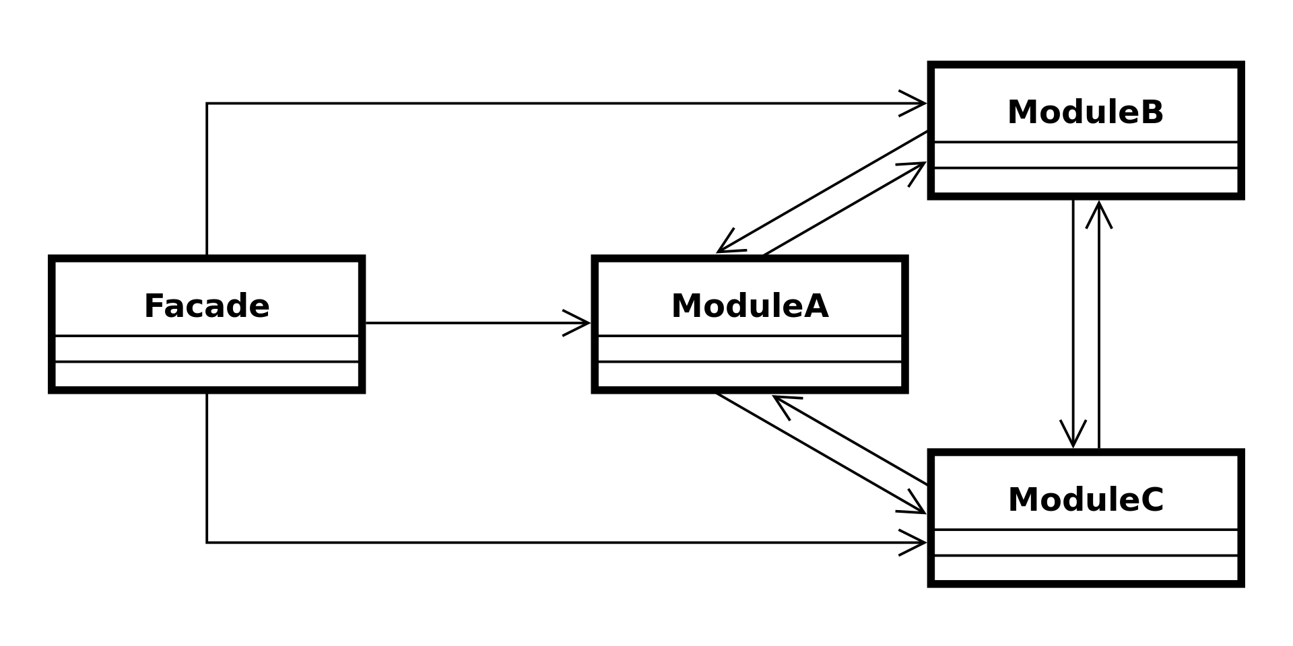
Facade - Structure
Notes:
Applicability
Use the Facade pattern when you need to have a limited but straightforward interface to a complex subsystem.
Often, subsystems get more complex over time. Even applying design patterns typically leads to creating more classes. A subsystem may become more flexible and easier to reuse in various contexts, but the amount of configuration and boilerplate code it demands from a client grows ever larger. The Facade attempts to fix this problem by providing a shortcut to the most-used features of the subsystem which fit most client requirements.
Use the Facade when you want to structure a subsystem into layers.
Create facades to define entry points to each level of a subsystem. You can reduce coupling between multiple subsystems by requiring them to communicate only through facades.
For example, let’s return to our video conversion framework. It can be broken down into two layers: video- and audio-related. For each layer, you can create a facade and then make the classes of each layer communicate with each another via those facades. This approach looks very similar to the Mediator pattern.

Slide 62
FACADE – Usage in C++
See:
FacadeSample Project in the code
Notes:
How to Implement
Check whether it’s possible to provide a simpler interface than what an existing subsystem already provides. You’re on the right track if this interface makes the client code independent from many of the subsystem’s classes.
Declare and implement this interface in a new facade class. The facade should redirect the calls from the client code to appropriate objects of the subsystem. The facade should be responsible for initializing the subsystem and managing its further life cycle unless the client code already does this.
To get the full benefit from the pattern, make all the client code communicate with the subsystem only via the facade. Now the client code is protected from any changes in the subsystem code. For example, when a subsystem gets upgraded to a new version, you will only need to modify the code in the facade.
If the facade becomes too big, consider extracting part of its behavior to a new, refined facade class.

Slide 63
Pros and Cons
You can isolate your code from the complexity of a subsystem.
A facade can become a god object coupled to all classes of an app.
Notes:
Relations with Other Patterns
Facade defines a new interface for existing objects, whereas Adapter tries to make the existing interface usable. Adapter usually wraps just one object, while Facade works with an entire subsystem of objects.
Abstract Factory can serve as an alternative to Facade when you only want to hide the way the subsystem objects are created from the client code.
Flyweight shows how to make lots of little objects, whereas Facade shows how to make a single object that represents an entire subsystem.
Facade and Mediator have similar jobs: they try to organize collaboration between lots of tightly coupled classes.
Facade defines a simplified interface to a subsystem of objects, but it doesn’t introduce any new functionality. The subsystem itself is unaware of the facade. Objects within the subsystem can communicate directly.
Mediator centralizes communication between components of the system. The components only know about the mediator object and don’t communicate directly.
A Facade class can often be transformed into a Singleton since a single facade object is sufficient in most cases.
Facade is similar to Proxy in that both buffer a complex entity and initialize it on its own. Unlike Facade, Proxy has the same interface as its service object, which makes them interchangeable.

Slide 64
Flyweight
Intent
Lets you fit more objects into the available amount of RAM by sharing common parts of state between multiple objects instead of keeping all of the data in each object.
Problem
You must implement a lightweight version of your application.
Your program must support a huge number of objects which barely fit into available RAM.

Slide 65
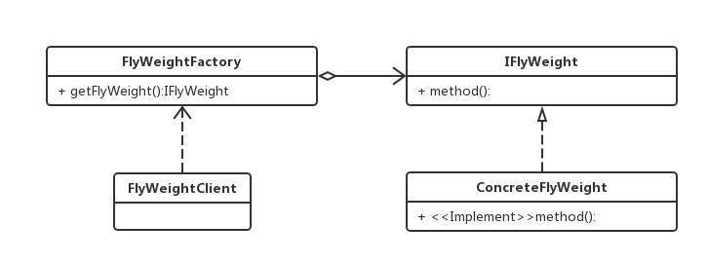
Flyweight - Structure
Notes:
Applicability
Use the Flyweight pattern only when your program must support a huge number of objects which barely fit into available RAM.
The benefit of applying the pattern depends heavily on how and where it’s used. It’s most useful when:
an application needs to spawn a huge number of similar objects
this drains all available RAM on a target device
the objects contain duplicate states which can be extracted and shared between multiple objects

Slide 66
Flyweight – Usage in C++
See:
FlyweightSample Project in the code
Notes:
How to Implement
Divide fields of a class that will become a flyweight into two parts:
the intrinsic state: the fields that contain unchanging data duplicated across many objects
the extrinsic state: the fields that contain contextual data unique to each object
Leave the fields that represent the intrinsic state in the class, but make sure they’re immutable. They should take their initial values only inside the constructor.
Go over methods that use fields of the extrinsic state. For each field used in the method, introduce a new parameter and use it instead of the field.
Optionally, create a factory class to manage the pool of flyweights. It should check for an existing flyweight before creating a new one. Once the factory is in place, clients must only request flyweights through it. They should describe the desired flyweight by passing its intrinsic state to the factory.
The client must store or calculate values of the extrinsic state (context) to be able to call methods of flyweight objects. For the sake of convenience, the extrinsic state along with the flyweight-referencing field may be moved to a separate context class.

Slide 67
Pros and Cons
You can save lots of RAM, assuming your program has tons of similar objects.
You might be trading RAM over CPU cycles when some of the context data needs to be recalculated each time somebody calls a flyweight method.
The code becomes much more complicated. New team members will always be wondering why the state of an entity was separated in such a way.
Notes:
Relations with Other Patterns
You can implement shared leaf nodes of the Composite tree as Flyweights to save some RAM.
Flyweight shows how to make lots of little objects, whereas Facade shows how to make a single object that represents an entire subsystem.
Flyweight would resemble Singleton if you somehow managed to reduce all shared states of the objects to just one flyweight object. But there are two fundamental differences between these patterns:
There should be only one Singleton instance, whereas a Flyweight class can have multiple instances with different intrinsic states.
The Singleton object can be mutable. Flyweight objects are immutable.

Slide 68
Proxy
Intent
Lets you provide a substitute or placeholder for another object. A proxy controls access to the original object, allowing you to perform something either before or after the request gets through to the original object.
Problem
You want to control access to an object.
Notes:
Applicability
There are dozens of ways to utilize the Proxy pattern. Let’s go over the most popular uses.
Lazy initialization (virtual proxy). This is when you have a heavyweight service object that wastes system resources by being always up, even though you only need it from time to time.
Instead of creating the object when the app launches, you can delay the object’s initialization to a time when it’s really needed.
Access control (protection proxy). This is when you want only specific clients to be able to use the service object; for instance, when your objects are crucial parts of an operating system and clients are various launched applications (including malicious ones).
The proxy can pass the request to the service object only if the client’s credentials match some criteria.
Local execution of a remote service (remote proxy). This is when the service object is located on a remote server.
In this case, the proxy passes the client request over the network, handling all of the nasty details of working with the network.
Logging requests (logging proxy). This is when you want to keep a history of requests to the service object.
The proxy can log each request before passing it to the service.
Caching request results (caching proxy). This is when you need to cache results of client requests and manage the life cycle of this cache, especially if results are quite large.
The proxy can implement caching for recurring requests that always yield the same results. The proxy may use the parameters of requests as the cache keys.
Smart reference. This is when you need to be able to dismiss a heavyweight object once there are no clients that use it.
The proxy can keep track of clients that obtained a reference to the service object or its results. From time to time, the proxy may go over the clients and check whether they are still active. If the client list gets empty, the proxy might dismiss the service object and free the underlying system resources.
The proxy can also track whether the client had modified the service object. Then the unchanged objects may be reused by other clients.

Slide 69
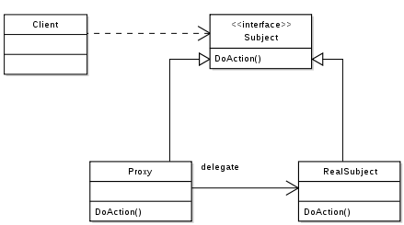
Proxy - Structure

Slide 70
Proxy – Usage in C++
See:
ProxySample Project in the code
Notes:
How to Implement
If there’s no pre-existing service interface, create one to make proxy and service objects interchangeable. Extracting the interface from the service class isn’t always possible, because you’d need to change all of the service’s clients to use that interface. Plan B is to make the proxy a subclass of the service class, and this way it’ll inherit the interface of the service.
Create the proxy class. It should have a field for storing a reference to the service. Usually, proxies create and manage the whole life cycle of their services. On rare occasions, a service is passed to the proxy via a constructor by the client.
Implement the proxy methods according to their purposes. In most cases, after doing some work, the proxy should delegate the work to the service object.
Consider introducing a creation method that decides whether the client gets a proxy or a real service. This can be a simple static method in the proxy class or a full-blown factory method.
Consider implementing lazy initialization for the service object.

Slide 71
Pros and Cons
You can control the service object without clients knowing about it.
You can manage the lifecycle of the service object when clients don’t care about it.
The proxy works even if the service object isn’t ready or is not available.
Open/Closed Principle. You can introduce new proxies without changing the service or clients.
The code may become more complicated since you need to introduce a lot of new classes.
The response from the service might get delayed.
Notes:
Relations with Other Patterns
Adapter provides a different interface to the wrapped object, Proxy provides it with the same interface, and Decorator provides it with an enhanced interface.
Facade is similar to Proxy in that both buffer a complex entity and initialize it on its own. Unlike Facade, Proxy has the same interface as its service object, which makes them interchangeable.
Decorator and Proxy have similar structures, but very different intents. Both patterns are built on the composition principle, where one object is supposed to delegate some of the work to another. The difference is that a Proxy usually manages the life cycle of its service object on its own, whereas the composition of Decorators is always controlled by the client.

Slide 72
Behavioral Design Patterns
Chain of Responsability
Command
Iterator
Mediator
Memento
Observer
State
Strategy
Template Method
Visitor

Slide 73
Chain of Responsability
Intent
Lets you pass requests along a chain of handlers.
Upon receiving a request, each handler decides either to process the request or to pass it to the next handler in the chain.
Problem
You must perform operations sequentially on more objects.

Slide 74
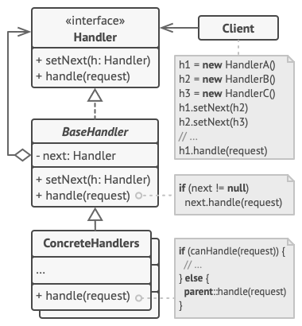
Chain of Responsability - Structure
Notes:
Applicability
Use the Chain of Responsibility pattern when your program is expected to process different kinds of requests in various ways, but the exact types of requests and their sequences are unknown beforehand.
The pattern lets you link several handlers into one chain and, upon receiving a request, “ask” each handler whether it can process it. This way all handlers get a chance to process the request.
Use the pattern when it’s essential to execute several handlers in a particular order.
Since you can link the handlers in the chain in any order, all requests will get through the chain exactly as you planned.
Use the CoR pattern when the set of handlers and their order are supposed to change at runtime.
If you provide setters for a reference field inside the handler classes, you’ll be able to insert, remove or reorder handlers dynamically.

Slide 75
Chain of Responsability – Usage in C++
See:
CoRSample Project in the code
Notes:
How to Implement
Declare the handler interface and describe the signature of a method for handling requests.
Decide how the client will pass the request data into the method. The most flexible way is to convert the request into an object and pass it to the handling method as an argument.
To eliminate duplicate boilerplate code in concrete handlers, it might be worth creating an abstract base handler class, derived from the handler interface.
This class should have a field for storing a reference to the next handler in the chain. Consider making the class immutable. However, if you plan to modify chains at runtime, you need to define a setter for altering the value of the reference field.
You can also implement the convenient default behavior for the handling method, which is to forward the request to the next object unless there’s none left. Concrete handlers will be able to use this behavior by calling the parent method.
One by one create concrete handler subclasses and implement their handling methods. Each handler should make two decisions when receiving a request:
Whether it’ll process the request.
Whether it’ll pass the request along the chain.
The client may either assemble chains on its own or receive pre-built chains from other objects. In the latter case, you must implement some factory classes to build chains according to the configuration or environment settings.
The client may trigger any handler in the chain, not just the first one. The request will be passed along the chain until some handler refuses to pass it further or until it reaches the end of the chain.
Due to the dynamic nature of the chain, the client should be ready to handle the following scenarios:
The chain may consist of a single link.
Some requests may not reach the end of the chain.
Others may reach the end of the chain unhandled.

Slide 76
Pros and Cons
You can control the order of request handling.
Single Responsibility Principle. You can decouple classes that invoke operations from classes that perform operations.
The proxy works even if the service object isn’t ready or is not available.
Open/Closed Principle. You can introduce new handlers into the app without breaking the existing client code.
Some requests may end up unhandled.
Notes:
Relations with Other Patterns
Chain of Responsibility, Command, Mediator and Observer address various ways of connecting senders and receivers of requests:
Chain of Responsibility passes a request sequentially along a dynamic chain of potential receivers until one of them handles it.
Command establishes unidirectional connections between senders and receivers.
Mediator eliminates direct connections between senders and receivers, forcing them to communicate indirectly via a mediator object.
Observer lets receivers dynamically subscribe to and unsubscribe from receiving requests.
Chain of Responsibility is often used in conjunction with Composite. In this case, when a leaf component gets a request, it may pass it through the chain of all of the parent components down to the root of the object tree.
Handlers in Chain of Responsibility can be implemented as Commands. In this case, you can execute a lot of different operations over the same context object, represented by a request.
However, there’s another approach, where the request itself is a Command object. In this case, you can execute the same operation in a series of different contexts linked into a chain.
Chain of Responsibility and Decorator have very similar class structures. Both patterns rely on recursive composition to pass the execution through a series of objects. However, there are several crucial differences.
The CoR handlers can execute arbitrary operations independently of each other. They can also stop passing the request further at any point. On the other hand, various Decorators can extend the object’s behavior while keeping it consistent with the base interface. In addition, decorators aren’t allowed to break the flow of the request.

Slide 77
Command
Intent
Turns a request into a stand-alone object that contains all information about the request.
Problem
You must implement various behavior for a objects.
Notes:
This transformation lets you pass requests as a method arguments, delay or queue a request’s execution, and support undoable operations.

Slide 78
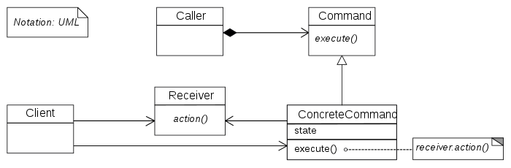
Command - Structure
Notes:
Applicability
Use the Command pattern when you want to parametrize objects with operations.
The Command pattern can turn a specific method call into a stand-alone object. This change opens up a lot of interesting uses: you can pass commands as method arguments, store them inside other objects, switch linked commands at runtime, etc.
Here’s an example: you’re developing a GUI component such as a context menu, and you want your users to be able to configure menu items that trigger operations when an end user clicks an item.
Use the Command pattern when you want to queue operations, schedule their execution, or execute them remotely.
As with any other object, a command can be serialized, which means converting it to a string that can be easily written to a file or a database. Later, the string can be restored as the initial command object. Thus, you can delay and schedule command execution. But there’s even more! In the same way, you can queue, log or send commands over the network.
Use the Command pattern when you want to implement reversible operations.
Although there are many ways to implement undo/redo, the Command pattern is perhaps the most popular of all.
To be able to revert operations, you need to implement the history of performed operations. The command history is a stack that contains all executed command objects along with related backups of the application’s state.
This method has two drawbacks. First, it isn’t that easy to save an application’s state because some of it can be private. This problem can be mitigated with the Memento pattern.
Second, the state backups may consume quite a lot of RAM. Therefore, sometimes you can resort to an alternative implementation: instead of restoring the past state, the command performs the inverse operation. The reverse operation also has a price: it may turn out to be hard or even impossible to implement.

Slide 79
Command – Usage in C++
See:
CommandSample Project in the code
Notes:
How to Implement
Declare the command interface with a single execution method.
Start extracting requests into concrete command classes that implement the command interface. Each class must have a set of fields for storing the request arguments along with a reference to the actual receiver object. All these values must be initialized via the command’s constructor.
Identify classes that will act as senders. Add the fields for storing commands into these classes. Senders should communicate with their commands only via the command interface. Senders usually don’t create command objects on their own, but rather get them from the client code.
Change the senders so they execute the command instead of sending a request to the receiver directly.
The client should initialize objects in the following order:
Create receivers.
Create commands, and associate them with receivers if needed.
Create senders, and associate them with specific commands.

Slide 80
Pros and Cons
Single Responsibility Principle. You can decouple classes that invoke operations from classes that perform these operations.
Open/Closed Principle. You can introduce new commands into the app without breaking existing client code.
You can implement undo/redo.
You can implement deferred execution of operations.
You can assemble a set of simple commands into a complex one.
The code may become more complicated since you’re introducing a whole new layer between senders and receivers.
Notes:
Relations with Other Patterns
Chain of Responsibility, Command, Mediator and Observer address various ways of connecting senders and receivers of requests:
Chain of Responsibility passes a request sequentially along a dynamic chain of potential receivers until one of them handles it.
Command establishes unidirectional connections between senders and receivers.
Mediator eliminates direct connections between senders and receivers, forcing them to communicate indirectly via a mediator object.
Observer lets receivers dynamically subscribe to and unsubscribe from receiving requests.
Handlers in Chain of Responsibility can be implemented as Commands. In this case, you can execute a lot of different operations over the same context object, represented by a request.
However, there’s another approach, where the request itself is a Command object. In this case, you can execute the same operation in a series of different contexts linked into a chain.
You can use Command and Memento together when implementing “undo”. In this case, commands are responsible for performing various operations over a target object, while mementos save the state of that object just before a command gets executed.
Command and Strategy may look similar because you can use both to parameterize an object with some action. However, they have very different intents.
You can use Command to convert any operation into an object. The operation’s parameters become fields of that object. The conversion lets you defer execution of the operation, queue it, store the history of commands, send commands to remote services, etc.
On the other hand, Strategy usually describes different ways of doing the same thing, letting you swap these algorithms within a single context class.
Prototype can help when you need to save copies of Commands into history.
You can treat Visitor as a powerful version of the Command pattern. Its objects can execute operations over various objects of different classes.

Slide 81
Iterator
Intent
Lets you traverse elements of a collection without exposing its underlying representation (list, stack, tree, etc.).
Problem
Collections are one of the most used data types in programming and a classic problem is iterate to.

Slide 82
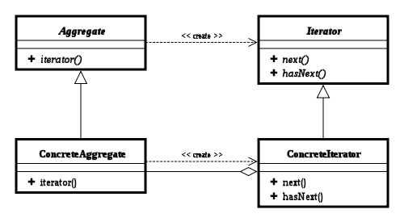
Iterator - Structure
Notes:
Applicability
Use the Iterator pattern when your collection has a complex data structure under the hood, but you want to hide its complexity from clients (either for convenience or security reasons).
The iterator encapsulates the details of working with a complex data structure, providing the client with several simple methods of accessing the collection elements. While this approach is very convenient for the client, it also protects the collection from careless or malicious actions which the client would be able to perform if working with the collection directly.
Use the pattern to reduce duplication of the traversal code across your app.
The code of non-trivial iteration algorithms tends to be very bulky. When placed within the business logic of an app, it may blur the responsibility of the original code and make it less maintainable. Moving the traversal code to designated iterators can help you make the code of the application more lean and clean.
Use the Iterator when you want your code to be able to traverse different data structures or when types of these structures are unknown beforehand.
The pattern provides a couple of generic interfaces for both collections and iterators. Given that your code now uses these interfaces, it’ll still work if you pass it various kinds of collections and iterators that implement these interfaces.

Slide 83
Iterator – Usage in C++
See:
IteratorSample Project in the code
Notes:
How to Implement
Declare the iterator interface. At the very least, it must have a method for fetching the next element from a collection. But for the sake of convenience you can add a couple of other methods, such as fetching the previous element, tracking the current position, and checking the end of the iteration.
Declare the collection interface and describe a method for fetching iterators. The return type should be equal to that of the iterator interface. You may declare similar methods if you plan to have several distinct groups of iterators.
Implement concrete iterator classes for the collections that you want to be traversable with iterators. An iterator object must be linked with a single collection instance. Usually, this link is established via the iterator’s constructor.
Implement the collection interface in your collection classes. The main idea is to provide the client with a shortcut for creating iterators, tailored for a particular collection class. The collection object must pass itself to the iterator’s constructor to establish a link between them.
Go over the client code to replace all of the collection traversal code with the use of iterators. The client fetches a new iterator object each time it needs to iterate over the collection elements.

Slide 84
Pros and Cons
Single Responsibility Principle. You can clean up the client code and the collections by extracting bulky traversal algorithms into separate classes.
Open/Closed Principle. You can implement new types of collections and iterators and pass them to existing code without breaking anything.
You can iterate over the same collection in parallel because each iterator object contains its own iteration state.
For the same reason, you can delay an iteration and continue it when needed.
Applying the pattern can be an overkill if your app only works with simple collections.
Using an iterator may be less efficient than going through elements of some specialized collections directly.
Notes:
Relations with Other Patterns
You can use Iterators to traverse Composite trees.
You can use Factory Method along with Iterator to let collection subclasses return different types of iterators that are compatible with the collections.
You can use Memento along with Iterator to capture the current iteration state and roll it back if necessary.
You can use Visitor along with Iterator to traverse a complex data structure and execute some operation over its elements, even if they all have different classes.

Slide 85
Mediator
Intent
Lets you reduce chaotic dependencies between objects.
The pattern restricts direct communications between the objects and forces them to collaborate only via a mediator object.
Problem
You have a different objects that interact and you must reuse it in different circumstances.

Slide 86
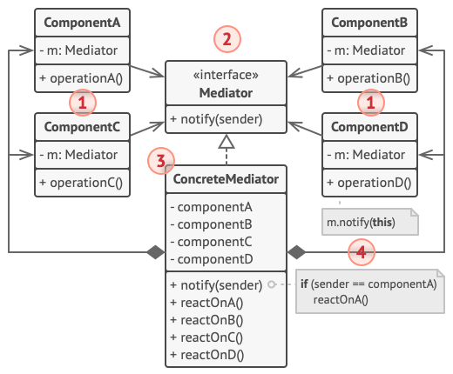
Mediator - Structure
Notes:
Applicability
Use the Mediator pattern when it’s hard to change some of the classes because they are tightly coupled to a bunch of other classes.
The pattern lets you extract all the relationships between classes into a separate class, isolating any changes to a specific component from the rest of the components.
Use the pattern when you can’t reuse a component in a different program because it’s too dependent on other components.
After you apply the Mediator, individual components become unaware of the other components. They could still communicate with each other, albeit indirectly, through a mediator object. To reuse a component in a different app, you need to provide it with a new mediator class.
Use the Mediator when you find yourself creating tons of component subclasses just to reuse some basic behavior in various contexts.
Since all relations between components are contained within the mediator, it’s easy to define entirely new ways for these components to collaborate by introducing new mediator classes, without having to change the components themselves.

Slide 87
Mediator – Usage in C++
See:
MediatorSample Project in the code
Notes:
How to Implement
Identify a group of tightly coupled classes which would benefit from being more independent (e.g., for easier maintenance or simpler reuse of these classes).
Declare the mediator interface and describe the desired communication protocol between mediators and various components. In most cases, a single method for receiving notifications from components is sufficient.
This interface is crucial when you want to reuse component classes in different contexts. As long as the component works with its mediator via the generic interface, you can link the component with a different implementation of the mediator.
Implement the concrete mediator class. This class would benefit from storing references to all of the components it manages.
You can go even further and make the mediator responsible for the creation and destruction of component objects. After this, the mediator may resemble a factory or a facade.
Components should store a reference to the mediator object. The connection is usually established in the component’s constructor, where a mediator object is passed as an argument.
Change the components’ code so that they call the mediator’s notification method instead of methods on other components. Extract the code that involves calling other components into the mediator class. Execute this code whenever the mediator receives notifications from that component.

Slide 88
Pros and Cons
Single Responsibility Principle. You can extract the communications between various components into a single place, making it easier to comprehend and maintain.
Open/Closed Principle. You can introduce new mediators without having to change the actual components.
You can reduce coupling between various components of a program.
You can reuse individual components more easily.
Over time a mediator can evolve into a God Object.
Notes:
Relations with Other Patterns
Chain of Responsibility, Command, Mediator and Observer address various ways of connecting senders and receivers of requests:
Chain of Responsibility passes a request sequentially along a dynamic chain of potential receivers until one of them handles it.
Command establishes unidirectional connections between senders and receivers.
Mediator eliminates direct connections between senders and receivers, forcing them to communicate indirectly via a mediator object.
Observer lets receivers dynamically subscribe to and unsubscribe from receiving requests.
Facade and Mediator have similar jobs: they try to organize collaboration between lots of tightly coupled classes.
Facade defines a simplified interface to a subsystem of objects, but it doesn’t introduce any new functionality. The subsystem itself is unaware of the facade. Objects within the subsystem can communicate directly.
Mediator centralizes communication between components of the system. The components only know about the mediator object and don’t communicate directly.
The difference between Mediator and Observer is often elusive. In most cases, you can implement either of these patterns; but sometimes you can apply both simultaneously. Let’s see how we can do that.
The primary goal of Mediator is to eliminate mutual dependencies among a set of system components. Instead, these components become dependent on a single mediator object. The goal of Observer is to establish dynamic one-way connections between objects, where some objects act as subordinates of others.
There’s a popular implementation of the Mediator pattern that relies on Observer. The mediator object plays the role of publisher, and the components act as subscribers which subscribe to and unsubscribe from the mediator’s events. When Mediator is implemented this way, it may look very similar to Observer.
When you’re confused, remember that you can implement the Mediator pattern in other ways. For example, you can permanently link all the components to the same mediator object. This implementation won’t resemble Observer but will still be an instance of the Mediator pattern.
Now imagine a program where all components have become publishers, allowing dynamic connections between each other. There won’t be a centralized mediator object, only a distributed set of observers.

Slide 89
Memento
Intent
Lets you save and restore the previous state of an object without revealing the details of its implementation.
Problem
Your business logic must implement a storage for instance’s state.

Slide 90
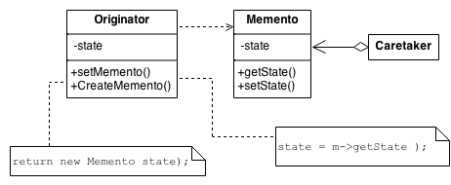
Memento - Structure
Notes:
Applicability
Use the Memento pattern when you want to produce snapshots of the object’s state to be able to restore a previous state of the object.
The Memento pattern lets you make full copies of an object’s state, including private fields, and store them separately from the object. While most people remember this pattern thanks to the “undo” use case, it’s also indispensable when dealing with transactions (i.e., if you need to roll back an operation on error).
Use the pattern when direct access to the object’s fields/getters/setters violates its encapsulation.
The Memento makes the object itself responsible for creating a snapshot of its state. No other object can read the snapshot, making the original object’s state data safe and secure.

Slide 91
Memento – Usage in C++
See:
MementoSample Project in the code
Notes:
How to Implement
Determine what class will play the role of the originator. It’s important to know whether the program uses one central object of this type or multiple smaller ones.
Create the memento class. One by one, declare a set of fields that mirror the fields declared inside the originator class.
Make the memento class immutable. A memento should accept the data just once, via the constructor. The class should have no setters.
If your programming language supports nested classes, nest the memento inside the originator. If not, extract a blank interface from the memento class and make all other objects use it to refer to the memento. You may add some metadata operations to the interface, but nothing that exposes the originator’s state.
Add a method for producing mementos to the originator class. The originator should pass its state to the memento via one or multiple arguments of the memento’s constructor.
The return type of the method should be of the interface you extracted in the previous step (assuming that you extracted it at all). Under the hood, the memento-producing method should work directly with the memento class.
Add a method for restoring the originator’s state to its class. It should accept a memento object as an argument. If you extracted an interface in the previous step, make it the type of the parameter. In this case, you need to typecast the incoming object to the memento class, since the originator needs full access to that object.
The caretaker, whether it represents a command object, a history, or something entirely different, should know when to request new mementos from the originator, how to store them and when to restore the originator with a particular memento.
The link between caretakers and originators may be moved into the memento class. In this case, each memento must be connected to the originator that had created it. The restoration method would also move to the memento class. However, this would all make sense only if the memento class is nested into originator or the originator class provides sufficient setters for overriding its state.

Slide 92
Pros and Cons
You can produce snapshots of the object’s state without violating its encapsulation.
You can simplify the originator’s code by letting the caretaker maintain the history of the originator’s state.
The app might consume lots of RAM if clients create mementos too often.
Caretakers should track the originator’s lifecycle to be able to destroy obsolete mementos.
Notes:
Most dynamic programming languages, such as PHP, Python and JavaScript, can’t guarantee that the state within the memento stays untouched.
Relations with Other Patterns
You can use Command and Memento together when implementing “undo”. In this case, commands are responsible for performing various operations over a target object, while mementos save the state of that object just before a command gets executed.
You can use Memento along with Iterator to capture the current iteration state and roll it back if necessary.
Sometimes Prototype can be a simpler alternative to Memento. This works if the object, the state of which you want to store in the history, is fairly straightforward and doesn’t have links to external resources, or the links are easy to re-establish.

Slide 93
Observer
Intent
Lets you define a subscription mechanism to notify multiple objects about any events that happen to the object they’re observing.
Problem
You must manage a change of state in an object by method in other object.

Slide 94
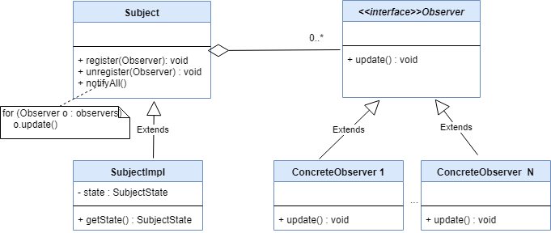
Observer - Structure
Notes:
Applicability
Use the Observer pattern when changes to the state of one object may require changing other objects, and the actual set of objects is unknown beforehand or changes dynamically.
You can often experience this problem when working with classes of the graphical user interface. For example, you created custom button classes, and you want to let the clients hook some custom code to your buttons so that it fires whenever a user presses a button.
The Observer pattern lets any object that implements the subscriber interface subscribe for event notifications in publisher objects. You can add the subscription mechanism to your buttons, letting the clients hook up their custom code via custom subscriber classes.
Use the pattern when some objects in your app must observe others, but only for a limited time or in specific cases.
The subscription list is dynamic, so subscribers can join or leave the list whenever they need to.

Slide 95
Observer – Usage in C++
See:
ObserverSample Project in the code
Notes:
How to Implement
Look over your business logic and try to break it down into two parts: the core functionality, independent from other code, will act as the publisher; the rest will turn into a set of subscriber classes.
Declare the subscriber interface. At a bare minimum, it should declare a single update method.
Declare the publisher interface and describe a pair of methods for adding a subscriber object to and removing it from the list. Remember that publishers must work with subscribers only via the subscriber interface.
Decide where to put the actual subscription list and the implementation of subscription methods. Usually, this code looks the same for all types of publishers, so the obvious place to put it is in an abstract class derived directly from the publisher interface. Concrete publishers extend that class, inheriting the subscription behavior.
However, if you’re applying the pattern to an existing class hierarchy, consider an approach based on composition: put the subscription logic into a separate object, and make all real publishers use it.
Create concrete publisher classes. Each time something important happens inside a publisher, it must notify all its subscribers.
Implement the update notification methods in concrete subscriber classes. Most subscribers would need some context data about the event. It can be passed as an argument of the notification method.
But there’s another option. Upon receiving a notification, the subscriber can fetch any data directly from the notification. In this case, the publisher must pass itself via the update method. The less flexible option is to link a publisher to the subscriber permanently via the constructor.
The client must create all necessary subscribers and register them with proper publishers.

Slide 96
Pros and Cons
You can produce snapshots of the object’s state without violating its encapsulation.
You can simplify the originator’s code by letting the caretaker maintain the history of the originator’s state.
The app might consume lots of RAM if clients create mementos too often.
Caretakers should track the originator’s lifecycle to be able to destroy obsolete mementos.
Notes:
Relations with Other Patterns
Chain of Responsibility, Command, Mediator and Observer address various ways of connecting senders and receivers of requests:
Chain of Responsibility passes a request sequentially along a dynamic chain of potential receivers until one of them handles it.
Command establishes unidirectional connections between senders and receivers.
Mediator eliminates direct connections between senders and receivers, forcing them to communicate indirectly via a mediator object.
Observer lets receivers dynamically subscribe to and unsubscribe from receiving requests.
The difference between Mediator and Observer is often elusive. In most cases, you can implement either of these patterns; but sometimes you can apply both simultaneously. Let’s see how we can do that.
The primary goal of Mediator is to eliminate mutual dependencies among a set of system components. Instead, these components become dependent on a single mediator object. The goal of Observer is to establish dynamic one-way connections between objects, where some objects act as subordinates of others.
There’s a popular implementation of the Mediator pattern that relies on Observer. The mediator object plays the role of publisher, and the components act as subscribers which subscribe to and unsubscribe from the mediator’s events. When Mediator is implemented this way, it may look very similar to Observer.
When you’re confused, remember that you can implement the Mediator pattern in other ways. For example, you can permanently link all the components to the same mediator object. This implementation won’t resemble Observer but will still be an instance of the Mediator pattern.
Now imagine a program where all components have become publishers, allowing dynamic connections between each other. There won’t be a centralized mediator object, only a distributed set of observers.

Slide 97
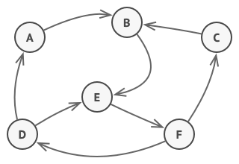
State
Intent
Lets an object alter its behavior when its internal state changes. It appears as if the object changed its class.
Problem
The State pattern is closely related to the concept of a Finite-State Machine.

Slide 98
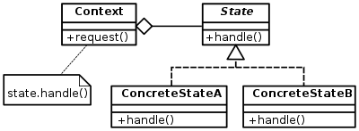
State - Structure
Notes:
Applicability
Use the State pattern when you have an object that behaves differently depending on its current state, the number of states is enormous, and the state-specific code changes frequently.
The pattern suggests that you extract all state-specific code into a set of distinct classes. As a result, you can add new states or change existing ones independently of each other, reducing the maintenance cost.
Use the pattern when you have a class polluted with massive conditionals that alter how the class behaves according to the current values of the class’s fields.
The State pattern lets you extract branches of these conditionals into methods of corresponding state classes. While doing so, you can also clean temporary fields and helper methods involved in state-specific code out of your main class.
Use State when you have a lot of duplicate code across similar states and transitions of a condition-based state machine.
The State pattern lets you compose hierarchies of state classes and reduce duplication by extracting common code into abstract base classes.

Slide 99
State – Usage in C++
See:
StateSample Project in the code
Notes:
How to Implement
Decide what class will act as the context. It could be an existing class which already has the state-dependent code; or a new class, if the state-specific code is distributed across multiple classes.
Declare the state interface. Although it may mirror all the methods declared in the context, aim only for those that may contain state-specific behavior.
For every actual state, create a class that derives from the state interface. Then go over the methods of the context and extract all code related to that state into your newly created class.
While moving the code to the state class, you might discover that it depends on private members of the context. There are several workarounds:
Make these fields or methods public.
Turn the behavior you’re extracting into a public method in the context and call it from the state class. This way is ugly but quick, and you can always fix it later.
Nest the state classes into the context class, but only if your programming language supports nesting classes.
In the context class, add a reference field of the state interface type and a public setter that allows overriding the value of that field.
Go over the method of the context again and replace empty state conditionals with calls to corresponding methods of the state object.
To switch the state of the context, create an instance of one of the state classes and pass it to the context. You can do this within the context itself, or in various states, or in the client. Wherever this is done, the class becomes dependent on the concrete state class that it instantiates.

Slide 100
Pros and Cons
Single Responsibility Principle. Organize the code related to particular states into separate classes.
Open/Closed Principle. Introduce new states without changing existing state classes or the context.
Simplify the code of the context by eliminating bulky state machine conditionals.
Applying the pattern can be overkill if a state machine has only a few states or rarely changes.
Notes:
Relations with Other Patterns
Bridge, State, Strategy (and to some degree Adapter) have very similar structures. Indeed, all of these patterns are based on composition, which is delegating work to other objects. However, they all solve different problems. A pattern isn’t just a recipe for structuring your code in a specific way. It can also communicate to other developers the problem the pattern solves.
State can be considered as an extension of Strategy. Both patterns are based on composition: they change the behavior of the context by delegating some work to helper objects. Strategy makes these objects completely independent and unaware of each other. However, State doesn’t restrict dependencies between concrete states, letting them alter the state of the context at will.

Slide 101
Strategy
Intent
Lets you define a family of algorithms, put each of them into a separate class, and make their objects interchangeable.
Problem
You must implement an application that must “decide” a way of solution.

Slide 102
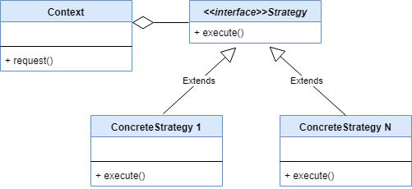
Strategy - Structure
Notes:
Applicability
Use the Strategy pattern when you want to use different variants of an algorithm within an object and be able to switch from one algorithm to another during runtime.
The Strategy pattern lets you indirectly alter the object’s behavior at runtime by associating it with different sub-objects which can perform specific sub-tasks in different ways.
Use the Strategy when you have a lot of similar classes that only differ in the way they execute some behavior.
The Strategy pattern lets you extract the varying behavior into a separate class hierarchy and combine the original classes into one, thereby reducing duplicate code.
Use the pattern to isolate the business logic of a class from the implementation details of algorithms that may not be as important in the context of that logic.
The Strategy pattern lets you isolate the code, internal data, and dependencies of various algorithms from the rest of the code. Various clients get a simple interface to execute the algorithms and switch them at runtime.
Use the pattern when your class has a massive conditional operator that switches between different variants of the same algorithm.
The Strategy pattern lets you do away with such a conditional by extracting all algorithms into separate classes, all of which implement the same interface. The original object delegates execution to one of these objects, instead of implementing all variants of the algorithm.

Slide 103
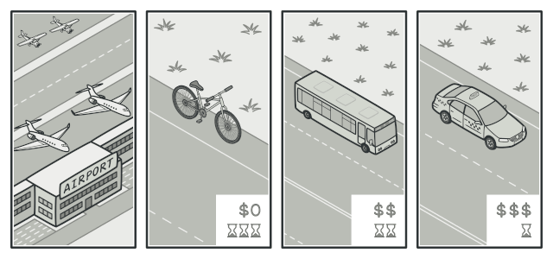
Real World Analogy
Various strategies for getting to the airport.

Slide 104
Strategy – Usage in C++
See:
StrategySample Project in the code
Notes:
How to Implement
In the context class, identify an algorithm that’s prone to frequent changes. It may also be a massive conditional that selects and executes a variant of the same algorithm at runtime.
Declare the strategy interface common to all variants of the algorithm.
One by one, extract all algorithms into their own classes. They should all implement the strategy interface.
In the context class, add a field for storing a reference to a strategy object. Provide a setter for replacing values of that field. The context should work with the strategy object only via the strategy interface. The context may define an interface which lets the strategy access its data.
Clients of the context must associate it with a suitable strategy that matches the way they expect the context to perform its primary job.

Slide 105
Pros and Cons
You can swap algorithms used inside an object at runtime.
You can isolate the implementation details of an algorithm from the code that uses it.
You can replace inheritance with composition.
Open/Closed Principle. You can introduce new strategies without having to change the context.
If you only have a couple of algorithms and they rarely change, there’s no real reason to overcomplicate the program with new classes and interfaces that come along with the pattern.
Clients must be aware of the differences between strategies to be able to select a proper one.
A lot of modern programming languages have functional type support that lets you implement different versions of an algorithm inside a set of anonymous functions.
Notes:
A lot of modern programming languages have functional type support that lets you implement different versions of an algorithm inside a set of anonymous functions. Then you could use these functions exactly as you’d have used the strategy objects, but without bloating your code with extra classes and interfaces.
Relations with Other Patterns
Bridge, State, Strategy (and to some degree Adapter) have very similar structures. Indeed, all of these patterns are based on composition, which is delegating work to other objects. However, they all solve different problems. A pattern isn’t just a recipe for structuring your code in a specific way. It can also communicate to other developers the problem the pattern solves.
Command and Strategy may look similar because you can use both to parameterize an object with some action. However, they have very different intents.
You can use Command to convert any operation into an object. The operation’s parameters become fields of that object. The conversion lets you defer execution of the operation, queue it, store the history of commands, send commands to remote services, etc.
On the other hand, Strategy usually describes different ways of doing the same thing, letting you swap these algorithms within a single context class.
Decorator lets you change the skin of an object, while Strategy lets you change the guts.
Template Method is based on inheritance: it lets you alter parts of an algorithm by extending those parts in subclasses. Strategy is based on composition: you can alter parts of the object’s behavior by supplying it with different strategies that correspond to that behavior. Template Method works at the class level, so it’s static. Strategy works on the object level, letting you switch behaviors at runtime.
State can be considered as an extension of Strategy. Both patterns are based on composition: they change the behavior of the context by delegating some work to helper objects. Strategy makes these objects completely independent and unaware of each other. However, State doesn’t restrict dependencies between concrete states, letting them alter the state of the context at will.

Slide 106
Template Method
Intent
Defines the skeleton of an algorithm in the superclass but lets subclasses override specific steps of the algorithm without changing its structure.
Problem
Manage a lot of different objects in the same algorithm.

Slide 107
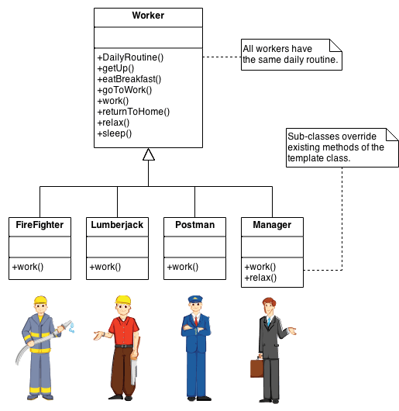
Template Method - Structure
Notes:
Use the Template Method pattern when you want to let clients extend only particular steps of an algorithm, but not the whole algorithm or its structure.
The Template Method lets you turn a monolithic algorithm into a series of individual steps which can be easily extended by subclasses while keeping intact the structure defined in a superclass.
Use the pattern when you have several classes that contain almost identical algorithms with some minor differences. As a result, you might need to modify all classes when the algorithm changes.
When you turn such an algorithm into a template method, you can also pull up the steps with similar implementations into a superclass, eliminating code duplication. Code that varies between subclasses can remain in subclasses.

Slide 108
Template Method – Usage in C++
See:
TemplateSample Project in the code
Notes:
How to Implement
Analyze the target algorithm to see whether you can break it into steps. Consider which steps are common to all subclasses and which ones will always be unique.
Create the abstract base class and declare the template method and a set of abstract methods representing the algorithm’s steps. Outline the algorithm’s structure in the template method by executing corresponding steps. Consider making the template method final to prevent subclasses from overriding it.
It’s okay if all the steps end up being abstract. However, some steps might benefit from having a default implementation. Subclasses don’t have to implement those methods.
Think of adding hooks between the crucial steps of the algorithm.
For each variation of the algorithm, create a new concrete subclass. It must implement all of the abstract steps, but may also override some of the optional ones.

Slide 109
Pros and Cons
You can let clients override only certain parts of a large algorithm, making them less affected by changes that happen to other parts of the algorithm.
You can pull the duplicate code into a superclass.
Some clients may be limited by the provided skeleton of an algorithm.
You might violate the Liskov Substitution Principle by suppressing a default step implementation via a subclass.
Template methods tend to be harder to maintain the more steps they have.
Notes:
Relations with Other Patterns
Factory Method is a specialization of Template Method. At the same time, a Factory Method may serve as a step in a large Template Method.
Template Method is based on inheritance: it lets you alter parts of an algorithm by extending those parts in subclasses. Strategy is based on composition: you can alter parts of the object’s behavior by supplying it with different strategies that correspond to that behavior. Template Method works at the class level, so it’s static. Strategy works on the object level, letting you switch behaviors at runtime.

Slide 110
Visitor
Intent
Lets you separate algorithms from the objects on which they operate.
Problem
You must process same data with more algorithms.

Slide 111
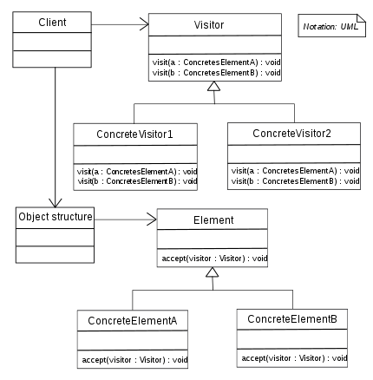
Visitor - Structure
Notes:
Applicability
Use the Visitor when you need to perform an operation on all elements of a complex object structure (for example, an object tree).
The Visitor pattern lets you execute an operation over a set of objects with different classes by having a visitor object implement several variants of the same operation, which correspond to all target classes.
Use the Visitor to clean up the business logic of auxiliary behaviors.
The pattern lets you make the primary classes of your app more focused on their main jobs by extracting all other behaviors into a set of visitor classes.
Use the pattern when a behavior makes sense only in some classes of a class hierarchy, but not in others.
You can extract this behavior into a separate visitor class and implement only those visiting methods that accept objects of relevant classes, leaving the rest empty.

Slide 112
Visitor – Usage in C++
See:
VisitorSample Project in the code
Notes:
How to Implement
Declare the visitor interface with a set of “visiting” methods, one per each concrete element class that exists in the program.
Declare the element interface. If you’re working with an existing element class hierarchy, add the abstract “acceptance” method to the base class of the hierarchy. This method should accept a visitor object as an argument.
Implement the acceptance methods in all concrete element classes. These methods must simply redirect the call to a visiting method on the incoming visitor object which matches the class of the current element.
The element classes should only work with visitors via the visitor interface. Visitors, however, must be aware of all concrete element classes, referenced as parameter types of the visiting methods.
For each behavior that can’t be implemented inside the element hierarchy, create a new concrete visitor class and implement all of the visiting methods.
You might encounter a situation where the visitor will need access to some private members of the element class. In this case, you can either make these fields or methods public, violating the element’s encapsulation, or nest the visitor class in the element class. The latter is only possible if you’re lucky to work with a programming language that supports nested classes.
The client must create visitor objects and pass them into elements via “acceptance” methods.

Slide 113
Pros and Cons
Open/Closed Principle. You can introduce a new behavior that can work with objects of different classes without changing these classes.
Single Responsibility Principle. You can move multiple versions of the same behavior into the same class.
A visitor object can accumulate some useful information while working with various objects.
You need to update all visitors each time a class gets added to or removed from the element hierarchy.
Visitors might lack the necessary access to the private fields and methods of the elements that they’re supposed to work with.
Notes:
Pros
This might be handy when you want to traverse some complex object structure, such as an object tree, and apply the visitor to each object of this structure.
Relations with Other Patterns
You can treat Visitor as a powerful version of the Command pattern. Its objects can execute operations over various objects of different classes.
You can use Visitor to execute an operation over an entire Composite tree.
You can use Visitor along with Iterator to traverse a complex data structure and execute some operation over its elements, even if they all have different classes.

